Slide 1

Teaching with Data

Slide 2
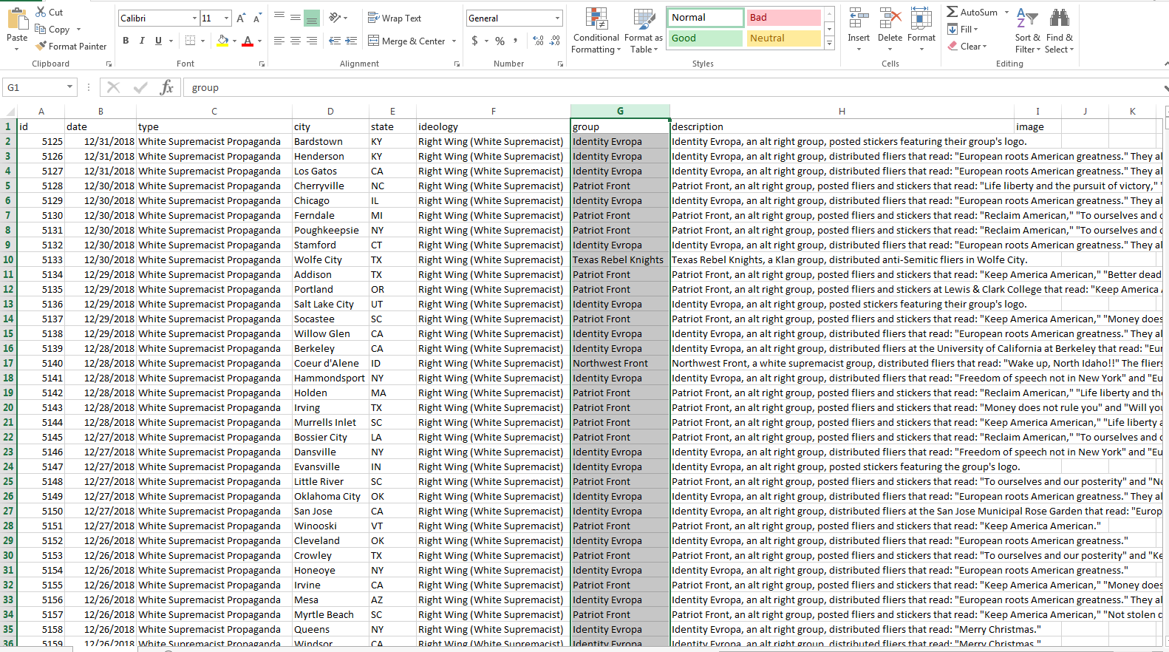


Anti-Defamation League (ADL) Data on Extremist Incidents in the U.S.
There are over 33,000 rows with data on U.S. extremist incidents from 2002 to 2022. While the data can be analyzed in Excel, a visualization tool (e.g. Tableau, Microsoft Power BI, etc.) is often quicker and easier.
Notes:
https://www.adl.org/, https://www.tableau.com

Slide 3


Exercise Scenario
For the purposes of this scenario, you are an intel analyst with the Department of Homeland Security (DHS). Your team leader assigned you the task of analyzing data from the Anti-Defamation League (ADL) to help plan counter-extremism resource allocation. Specific questions to answer include:
  Are incidents increasing or decreasing?
  Who (what ideology) commits the most incidents?
  What type(s) of incidents are most common?
  Which group(s) commit the most incidents?
  Where do most incidents occur?
  What additional data would
  be helpful in making a more
  accurate assessment?
Notes:
Omission of key variables, correlation does not equal causation, attributing meaning to small differences (qualitative analyses can help here), ignoring outliers, missing data, relies on objective decision-making by researchers, bias in data source.
https://www.adl.org/
https://www.dhs.gov/

Slide 4

Exercise Scenario II
Your due-out is a PPT file that answers the questions above.
Analyze the data in Tableau to answer the questions.
In Tableau, go to File (upper-left) and select Export as PowerPoint.
Check the PPT to make sure it has everything, and it looks legible, then save and send to the professor using Blackboard
Now let’s switch to Tableau and get started!
Notes:
https://www.adl.org/
https://www.dhs.gov/

Slide 5

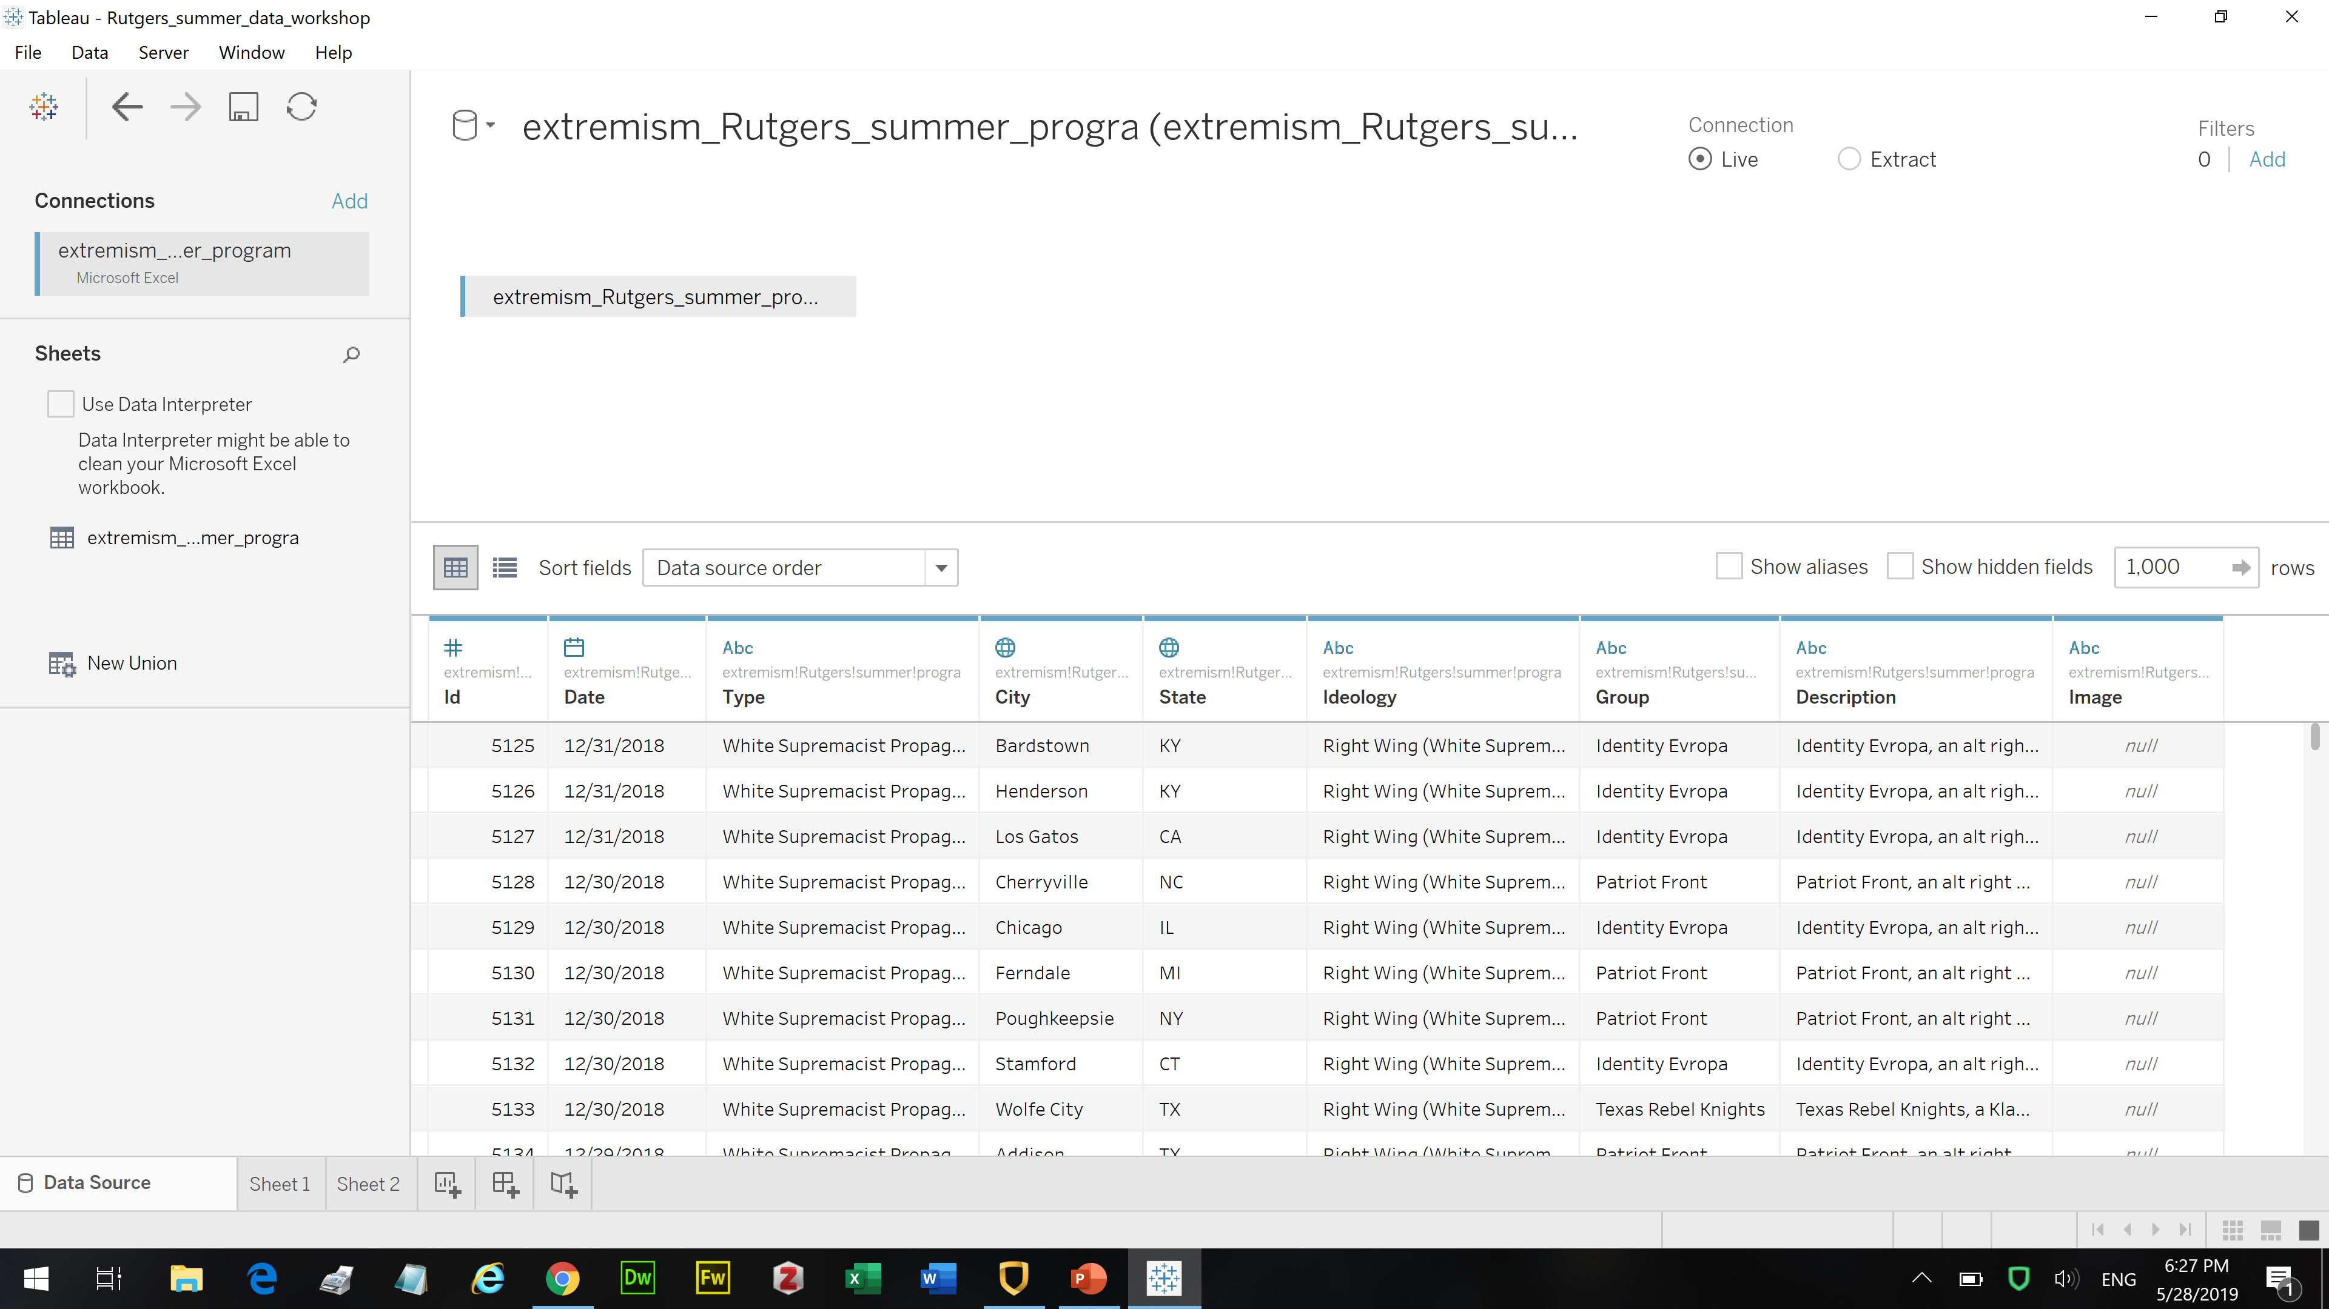
Fire up Tableau and let’s get started!
Once linked to a data connection, in this case a spreadsheet, Tableau should look similar to the screenshot below, minus the arrow.

